Slide 1
Team 5 Conceptual Design
Dillon Williams
Nidhay Patel
Ryan Reed
Michel Turpeau
Austin Sigg

Slide 2
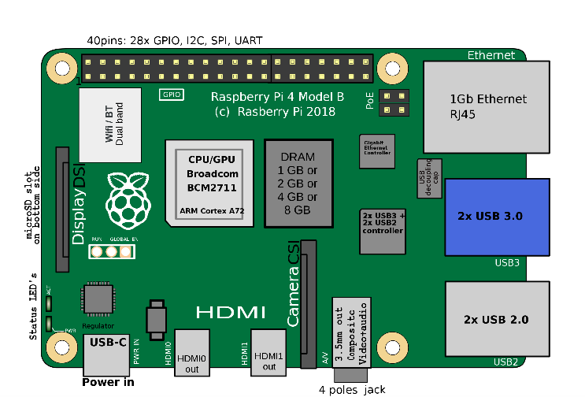
Microcontroller
Raspberry Pi Model 4 B
Card Reader
Input: Signal/Message/Information from Eagle Card
Output: Create Data and signal Microcontroller Unit
UI
Raspberry Pi LCD touchscreen
Input: Information from Student
Output: Raspberry Pi signaling PLC

Slide 3
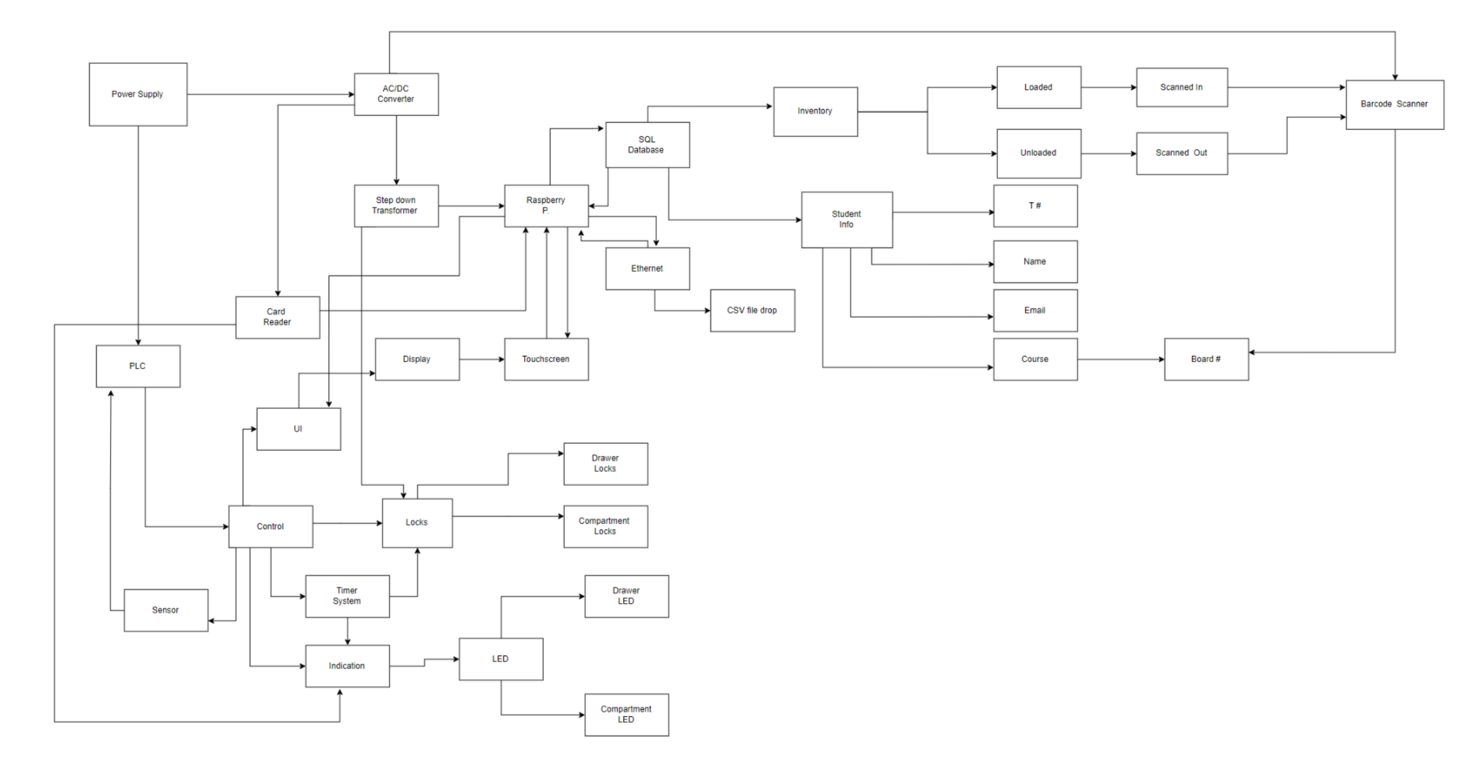

Slide 4
Dillon

Slide 5
Ryan

Slide 6
Mick

Slide 7
Sigg

